Slide 1
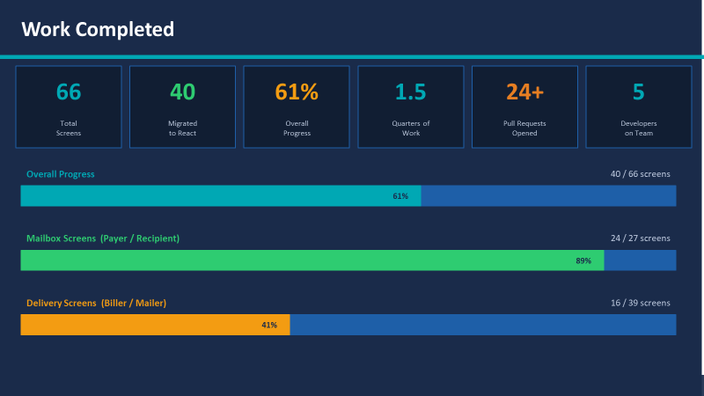
Payreq Frontend
Ember to React Migration
June 12, 2026

Slide 2
Teams Roles:
Brandon Galli - Product Owner / App Dev
Eyob Worku - Scrum Master / AI
Gunhee Kim - App Dev
Diep Huynh - App Dev
Henry Kirykovich – App Dev

Slide 3
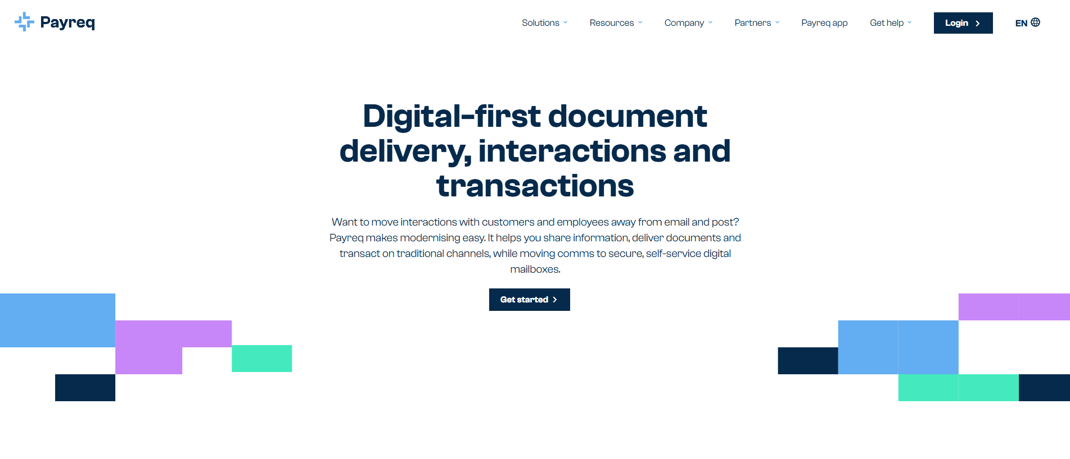
Who is Payreq?
Introduction
Payreq is a digital-first platform founded in 2015 that helps organizations deliver documents, manage billing, and process payments securely replacing paper, post, and email with secure Smart Mailboxes.
Key Features of Payreq
Bill & Pay: Manages customer billing, delivers documents securely, and automates payments using any method in one platform.
Built for Everyone: Serving enterprises, governments, and all sized organizations with billing, payroll, document delivery, e-Invoicing, and group billing solutions.
Smart Mailboxes: Replaces paper, post, and email with secure self-service digital mailboxes for convenience and safety.
Flexible Payments: Supports multiple payment methods including cards, bank accounts, Apple Pay, and auto-payments.
Global Reach: Operating across Australia, Canada, and the United States serving businesses of all sizes.
Notes:
Introduce Payreq as a digital-first platform revolutionizing document delivery, billing, and payments by moving away from paper, post, and email. Highlight its secure, automated communications and payment processing. Emphasize its broad market reach and tailored solutions for billing, payroll, and eInvoicing. Note the benefits of secure digital mailboxes and flexible payment options. The image reflects Payreq’s modern, clean, and professional brand identity.

Slide 4
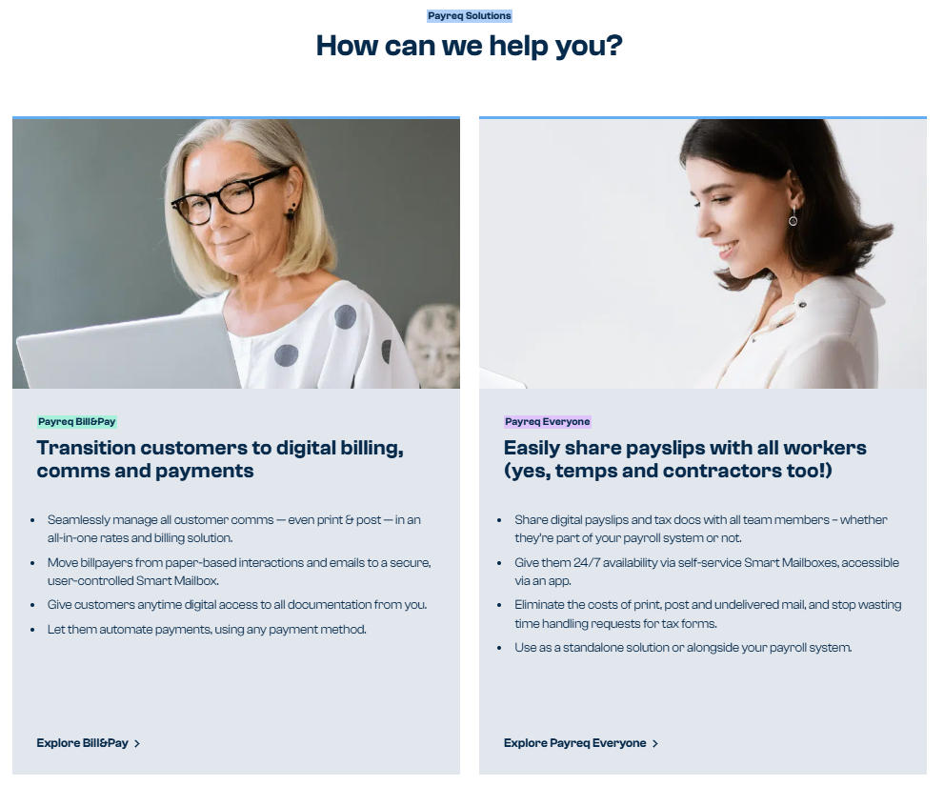
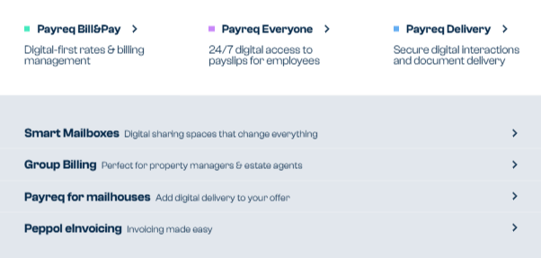
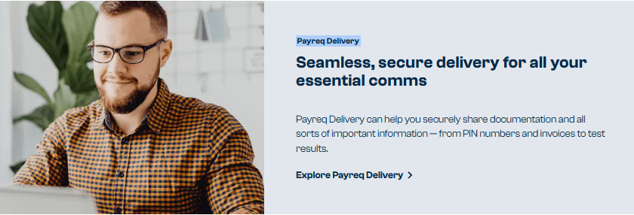
Payreq.com

Slide 5
The Big Picture
Overview
Our team migrated the Payreq biller portal from Ember.js to React — screen by screen on a live production codebase used by real customers.
Progress & Approach
25 delivery screens identified for migration
Each screen went through feature branch, peer review for final Payreq's approval
Used AI tools to analyze legacy code and generate React components
Maintained a shared migration tracker to coordinate the team
Team Contributions
Eyob - Channel Errors, User Notifications, Accounting Payment, Bill Detail, Registrations
Henry - Connections, Account Permissions, User Detail, Create User
Gunhee - Consents, Bill Templates, Channel Partner Settings, Accounting Settings, Bills List
Diep - Payments Settings, Users List, Import screen
Brandon - Product Owner, core migration work, coordination with Payreq sponsors
Notes:
This slide communicates the significance of completing the Payreq frontend migration to React.js. Emphasize how the entire user interface has been transformed, replacing the old legacy frontend with a modern, unified React codebase. Highlight the benefits for both users, such as consistent UI and faster navigation, and developers, including better maintainability and scalability. Use this slide to underline the foundational impact this migration has on Payreq's future growth and product quality.

Slide 6
PROCEDURE
How We Approached the Capstone
Four phases, twenty-five screens, one team finding its rhythm.
ALIGN
★
PIVOT
↻
BUILD
⚡
REVIEW
✓
1
2
3
4
→
→
→
Kickoff &
Setup
Find the
Approach
Migrate
Screen by Screen
Sponsor
Review
Talked to the sponsor, locked the scope, got everyone on the same channel.
First plan didn't scale — we switched to one screen at a time.
AI drafted, humans polished, monkey testing for QA, reviewer signed off.
Payreq senior eng pulled main, gave feedback, made us sharper each round.
" It wasn't the plan that worked, it was the rhythm we found." ·
Copyright 2026
6

Slide 7
PROCEDURE · PHASE 1 · WEEK ZERO
Kickoff & Setup
First we talked to the sponsor, to each other, to the legacy code. Then we built our launchpad.
★
25
✉
⚙
🔗
Sponsor Sync
25 Screens Identified
Channels Established
Environment Ready
Test Account
Discussed scope, asked clarifying questions, agreed on what "done" looks like.
Catalogued the delivery screens with each developer's ownership.
Slack + Discord workspaces, recurring standups, a sprint cadence.
Cloned from Bitbucket, installed deps, ran the legacy app parity.
Payreq reference URL our ground truth for every migrated screen.
1
2
3
4
5
End of week 1: we hadn't shipped a line of React — and we'd never been more ready to.
Copyright 2026
7

Slide 8
PROCEDURE · PHASE 2 & 3
Finding Our Rhythm: Screen by Screen
Our first approach didn't scale, so we pivoted. One screen at a time, one owner, one reviewer.
★ THE PIVOT
×
BEFORE
All screens at once
Merge conflicts, hard to review, blocked work
✓
NOW
One screen at a time
One owner + one reviewer · clean PRs
→
01
02
03
04
05
06
07
Specs
Code
Review
Test
PR
QA
Merge
AI extracts specs from Ember
AI generates React component
Owner reads & cleans up
Run locally · parity check
Open pull request
Monkey jumping test
Approved & merged to main
AI - ASSISTED
HUMAN - LED
Copyright 2026
8

Slide 9
PROCEDURE · PHASE 4
Sponsor Review & Feedback
Every merged screen went back to Payreq. The reviewer's notes shaped how we built the next one.
×25
screens
reviewed by Payreq
senior engineer per screen
Merge
Refine
Review
Senior engineer pulls main Branch handed off after QA — pulls and runs locally.
↻
Reviews against production standards Code style, naming, Bootstrap usage, role behaviour.
Gives focused feedback Specific notes per file/line in PR comments.
Feedback
Refine + repeat per screen Apply notes, re-test, move on — patterns sharpen.
" Each round of feedback compounded — by screen 25 we were writing review-ready PRs on the first try. "
Copyright 2026
9

Slide 10
THE STACK
Technologies Used
Front-end migration the stack we built, the AI we partnered with, the tools we shipped on.
FRONTEND
AI TOOLS
TEAM TOOLING
React
ChatGPT
VS Code · Docker
Modern framework · hooks
Specs · refactors · Q&A
Local dev environment
Ember.js
Claude Code
Git · Bitbucket
Legacy source of truth
Agentic coding · reviews
Version control · PRs
Bootstrap
Cursor
Slack · Discord
Existing UI styles preserved
AI-native editor
Communication
Gemini
Cross-checks · summaries
Copilot
Inline suggestions
Frontend-only migration · backend services were untouched
Copyright 2026
10

Slide 11
WHAT WE HIT · HOW WE GOT THROUGH
Challenges We Faced
The hardest parts of the migration and how we worked through them.
1
Legacy Ember Code
2
Matching UI Styling
3
Merge Conflicts
Hash-based routing, computed properties, nested templates no direct React equivalent. Reverse-engineered each screen before rewriting.
Ensuring React screens looked identical to Ember same fonts, spacing, Bootstrap classes. Small visual diffs required multiple iterations.
Shared files (AppRouter.js, SettingsShell.js, en.json) modified simultaneously. Constant rebasing, communication, and coordination.
4
PR Review Cycles
5
Testing Two Roles
6
How We Overcame
Multiple rounds of change requests under a tight deadline. Learned to write clean, reviewable code while keeping development velocity high.
Features behave differently per user role. Mocked biller and payer scenarios team stand-ups clarified expected behavior per screen.
Regular team meetings, clear PR descriptions, and AI-assisted tooling (Copilot, ChatGPT, Claude Code) accelerated understanding of legacy patterns.
Copyright 2026
11
Notes:
Of course, we faced some challenges. One of the biggest challenges was understanding the legacy Ember code before rewriting it in React. We also had to resolve merge conflicts between team members and make sure the new screens looked exactly like the original ones.
To overcome these challenges, we worked closely as a team, held regular meetings, reviewed each other's code, and used AI tools to better understand the existing application.
Overall, this project gave us valuable experience working with a large codebase, collaborating as a development team, and modernizing a real-world application.

Slide 12


CAPSTONE REFLECTION
What We Learned
The main things we learned while working on this project with Payreq.

Slide 13





HOW WE WORKED
What We Learned About the Work
Break big work into small pieces
Doing everything at once caused problems. Working on one screen at a time let everyone make progress without getting in each other's way.
AI helps, but people are responsible
AI wrote the first draft of each screen, which saved time. A team member still read, fixed, and tested every line before it went in.
Always check against the real thing
We compared every screen with the live Payreq site. Code that runs is not always code that is correct.
Give every task a clear owner
Each screen had one person building it and one person checking it, so nothing was missed and someone was always responsible.
Good preparation saves time
We wrote no code in the first week, but agreeing on the plan, tools, and access early made everything after that faster.

Slide 14





WORKING WITH A REAL CLIENT
What We Learned From Our Client
Working code is not enough
Payreq checked how our code was written and named, not just whether it ran. We learned to write code that others can read and maintain.
Feedback makes you better
Every review taught us a bit more about what the client expected, and we used those lessons on the next screen.
Working inside a real company
We had our own branch, Slack access, and accounts, and learned how to work safely inside a company's live systems.
Talk often to stay on the same page
Regular meetings and shared channels meant everyone knew what was happening, and small problems were caught early.
Change the plan when it is not working
We saw early that our first plan was failing, so we switched to a better one instead of pushing through.

